Slide 1
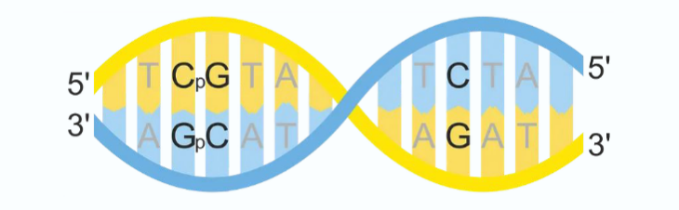
CpG Islands

Slide 2
CpG Islands
Regions of DNA with a high frequency of CpG sites, where a cytosine nucleotide is followed by a guanine nucleotide in the linear sequence of bases along its 5′→3′ direction.
The CG pair of nucleotides is the most infrequent dinucleotide in many genomes. This is because cytosines C in CpG dinucleotides are vulnerable to a process, called methylation ( that is, an H-atom is replaced by a CH3 – group), that can change with a high chance in mutating to a T.
The methylation process is suppressed in areas around promoter region of genes where transcription begins and hence these areas contain a relatively high concentration of the CpG dinucleotide. Such regions are called CpG islands, whose length varies from few hundreds to few thousands bases.

Slide 3
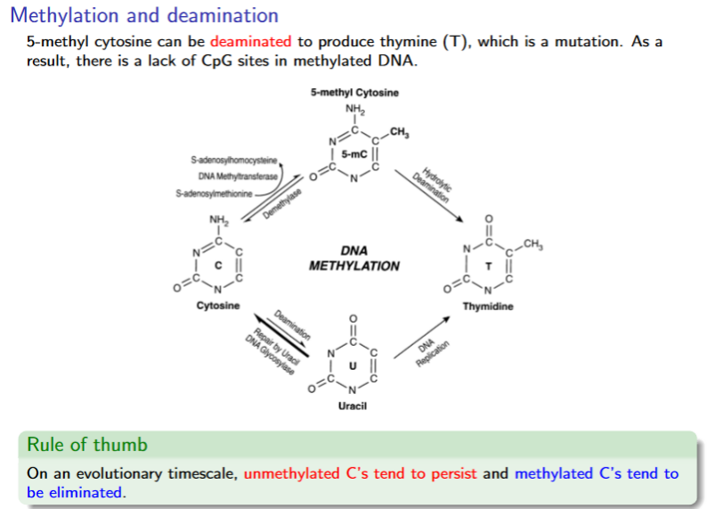
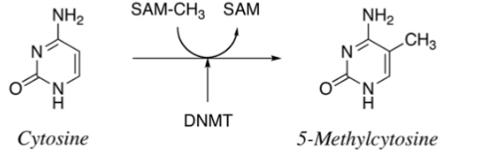
Methylation

Slide 4
CpG Islands
CpG-islands are useful markers for genes in organisms
CpG-islands in the promoter-regions of genes play an important role in the deactivation of one copy of the X-chromosome in females, in genetic imprinting and in the deactivation of intra-genomic parasites.
Human Chromosomes 21 and 22 contain about 1100 CpG-islands and about 750 genes.

Slide 5
CpG Islands
Almost all cells in an organism have the same DNA sequence. The difference lies in the levels of gene expression.
One common way that genes are turned off is by a chemical change called methylation at the promoter CGI. Promoter regions of housekeeping genes are usually unmethylated.
Appropriate methylation of CGIs is needed for normal development. If methylation occurs when it should not in tumor suppression genes, then problems such as cancer can result.
In mammals, 70-80% of CpG cytosines are methylated, but it depends on the type of cell. For example, hemoglobin genes should be methylated (and shut off) in skin cells but unmethylated (and expressed) in red blood precursors.

Slide 6
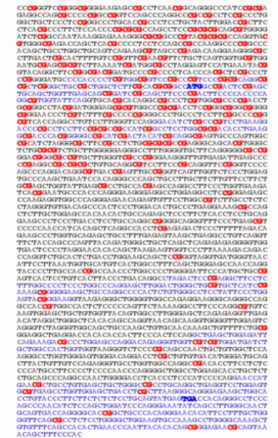
The sample is of a gene-promoter , the highlighted ATG constitutes the start codon

Slide 7
CpG Characterization
A sequence in a vertebrate genome is CpG island if:
(1) it has length at least 200 bp
(2) C + G content of at least 50 %
(3) observed-to-expected number of CpG’s above 60 %
Expected number of CpGs = (#C’s). (#G’s) / length of sequence

Slide 8
MATLAB Function – cpgisland https://www.mathworks.com/help/bioinfo/ref/cpgisland.html
Cpgisland - Locate CpG islands in DNA sequence
Syntax
cpgStruct = cpgisland(SeqDNA)
cpgStruct = cpgisland(SeqDNA, ...'Window', WindowValue, ...)
cpgStruct = cpgisland(SeqDNA, ...'MinIsland', MinIslandValue, ...)
cpgStruct = cpgisland(SeqDNA, ...'GCmin', GCminValue, ...)
cpgStruct = cpgisland(SeqDNA, ...'CpGoe', CpGoeValue, ...)
cpgStruct = cpgisland(SeqDNA, ...'Plot', PlotValue, ...)

Slide 9
MATLAB Function – cpgisland Input Arguments
SeqDNA | One of the following: Character vector or string specifying a nucleotide sequence Row vector of integers specifying a nucleotide sequence MATLAB® structure containing a Sequence field that contains a DNA nucleotide sequence, such as returned by fastaread, fastqread, emblread, getembl, genbankread, or getgenbank Valid characters include A, C, G, and T. cpgisland does not count ambiguous nucleotides or gaps.
WindowValue | Integer specifying the window size for calculating GC content and CpGobserved/CpGexpected ratios. Default is 100 bases. A smaller window size increases the noise in a plot.
MinIslandValue | Integer specifying the minimum number of consecutive marked bases to report as a CpG island. Default is 200 bases.
GCminValue | Value specifying the minimum GC percent in a window needed to mark a base. Choices are a value between 0 and 1. Default is 0.5.
CpGoeValue | Value specifying the minimum CpGobserved/CpGexpected ratio in each window needed to mark a base. Choices are a value between 0 and 1. Default is 0.6. This ratio is defined as: CPGobs/CpGexp = (NumCpGs*Length)/(NumGs*NumCs)
PlotValue | Controls the plotting of GC content, CpGoe content, CpG islands greater than the minimum island size, and all potential CpG islands for the specified criteria. Choices are true or false (default).

Slide 10
Example
Import a nucleotide sequence from the GenBank® database. For example, retrieve a sequence from Homo sapiens chromosome 12.
S = getgenbank('AC156455');
Calculate the CpG islands in the sequence and plot the results.
cpgisland(S.Sequence,'PLOT',true)
ans =
Starts: [4510 29359]
Stops: [5468 29604]
The CpG islands greater than 200 bases in length are listed and a plot displays.

Slide 11
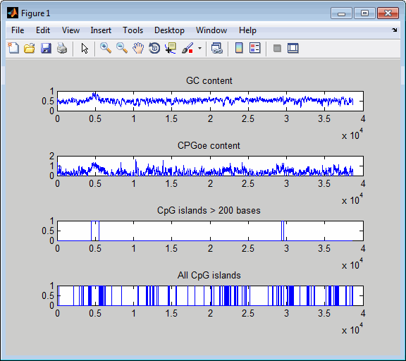
Starts: [4510 29359]
Stops: [5468 29604]

Slide 12
CpG Identification Questions Markov Chains & Markov Models
1. Given a (short) segment of genomic sequence.
How to decide whether this segment is from a CpG-island or not? -
2. Give a (long) segment of genomic sequence.
How to find all CpG-islands contained in it?

Slide 13
Markov Chains
A probabilistic model for the CGI is needed.
A model in which the probability of one symbol is dependent on the predecessor need to be developed.
This dependency can be captured by the concept of a Markov Chain.

Slide 14
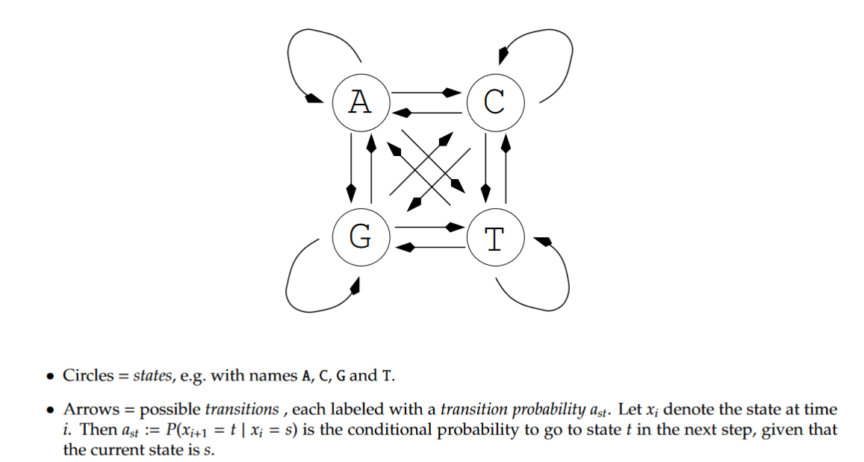
Markov Chains

Slide 15
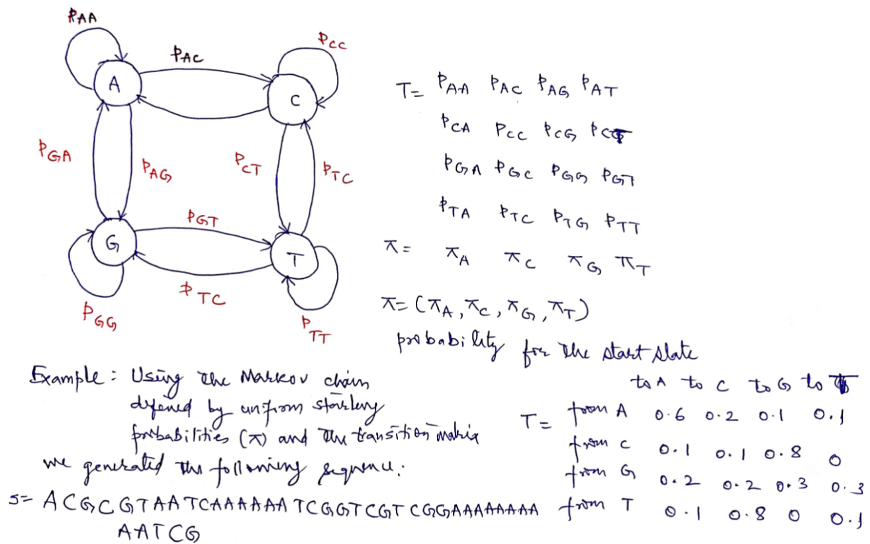
Markov Model for Genomic Sequences

Slide 16
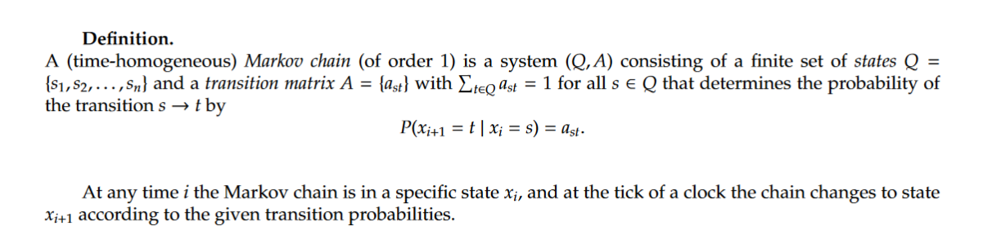
Markov Chain Definition

Slide 17
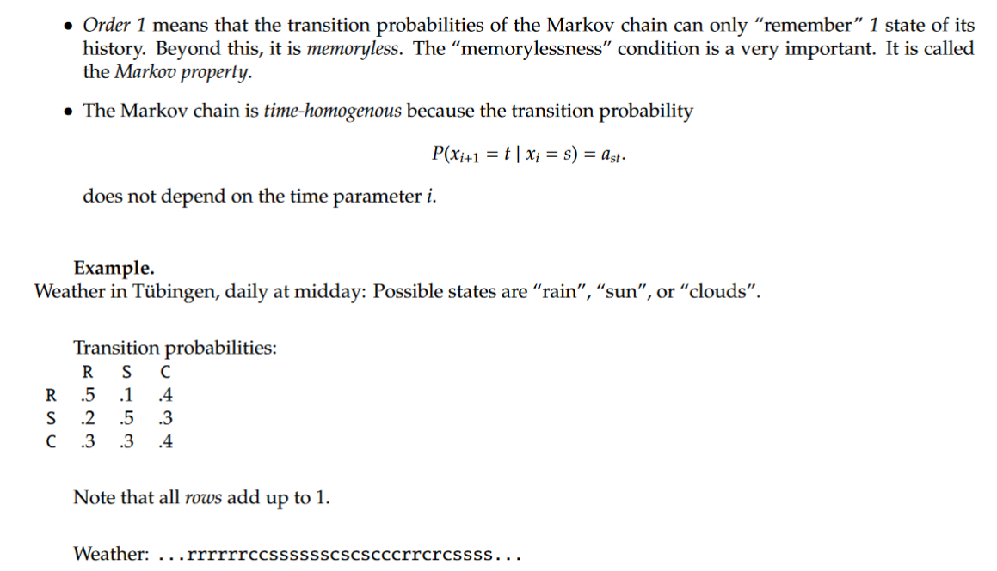
Terminology

Slide 18

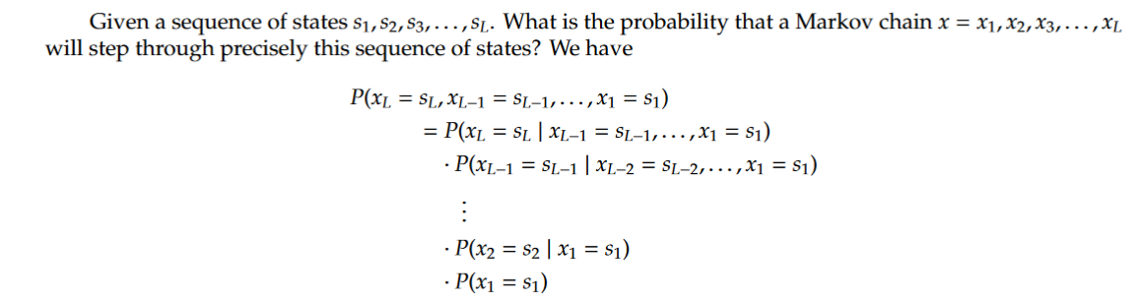
Markov Chain Probability

Slide 19
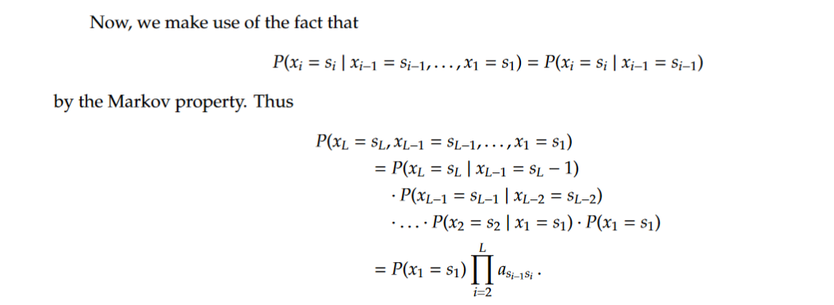
Markov Chain Probability

Slide 20
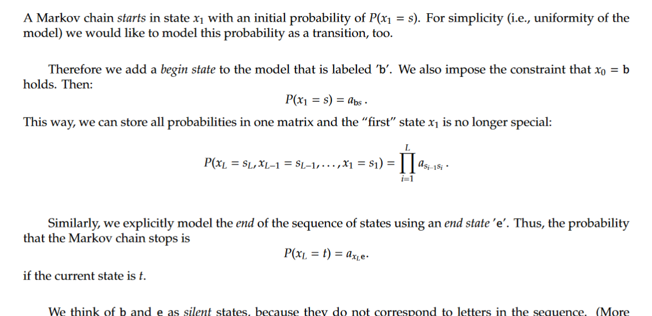
Modeling the begin and end states

Slide 21
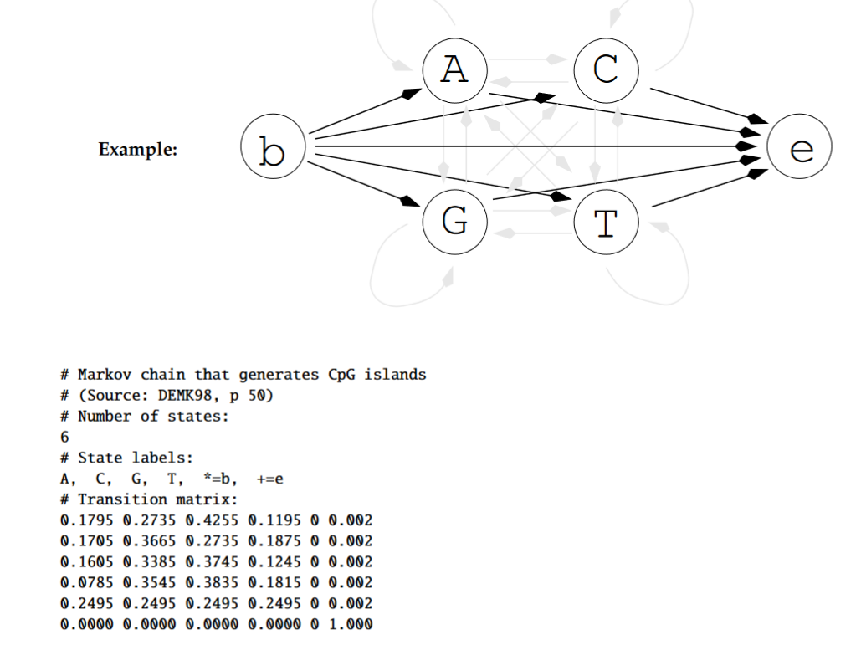
Markov Chain for CGI

Slide 22
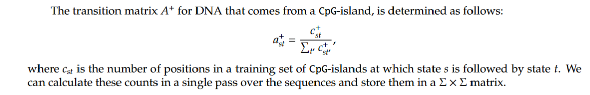
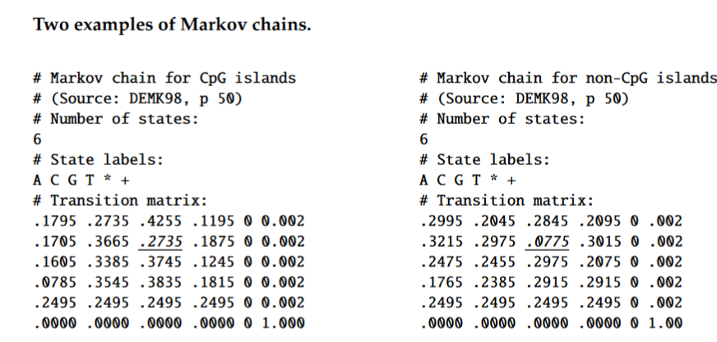
Determination of Transition Matrix

Slide 23
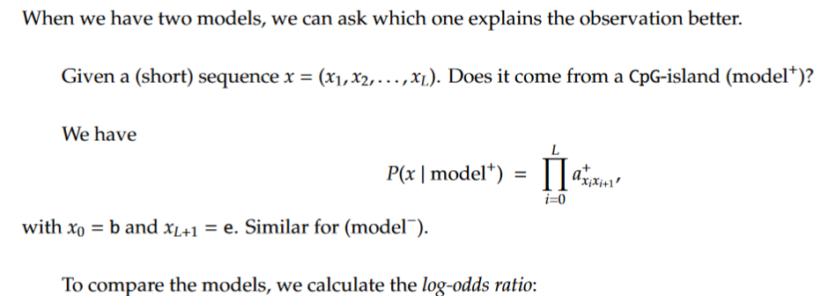
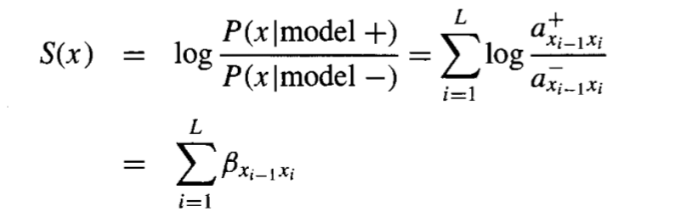
Using Markov Chains For Discrimination

Slide 24
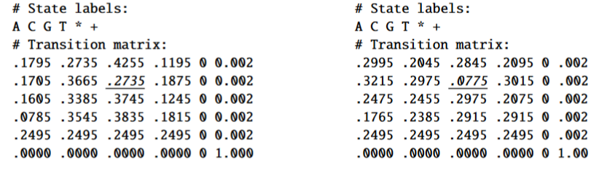
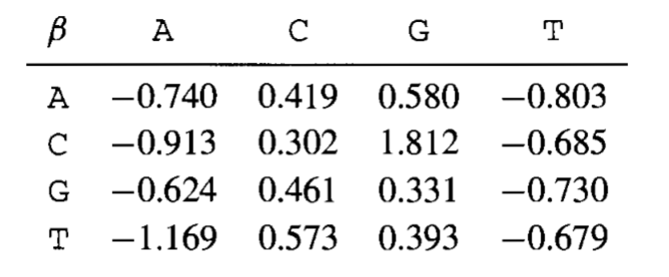


Slide 25

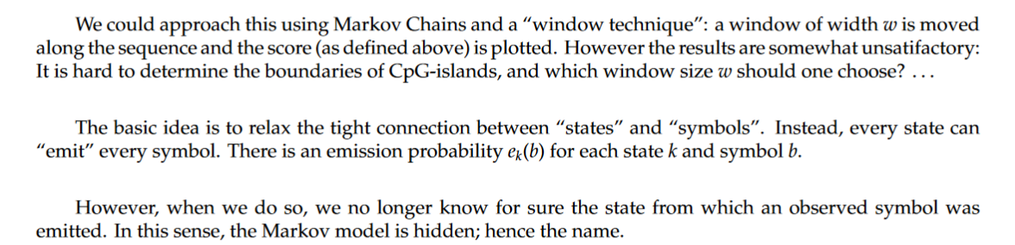
Hidden Markov Model

Slide 26
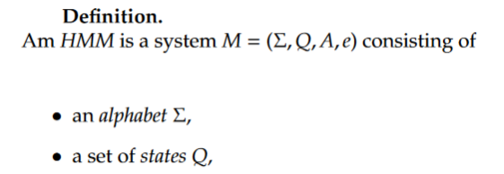

Hidden Markov Model

Slide 27
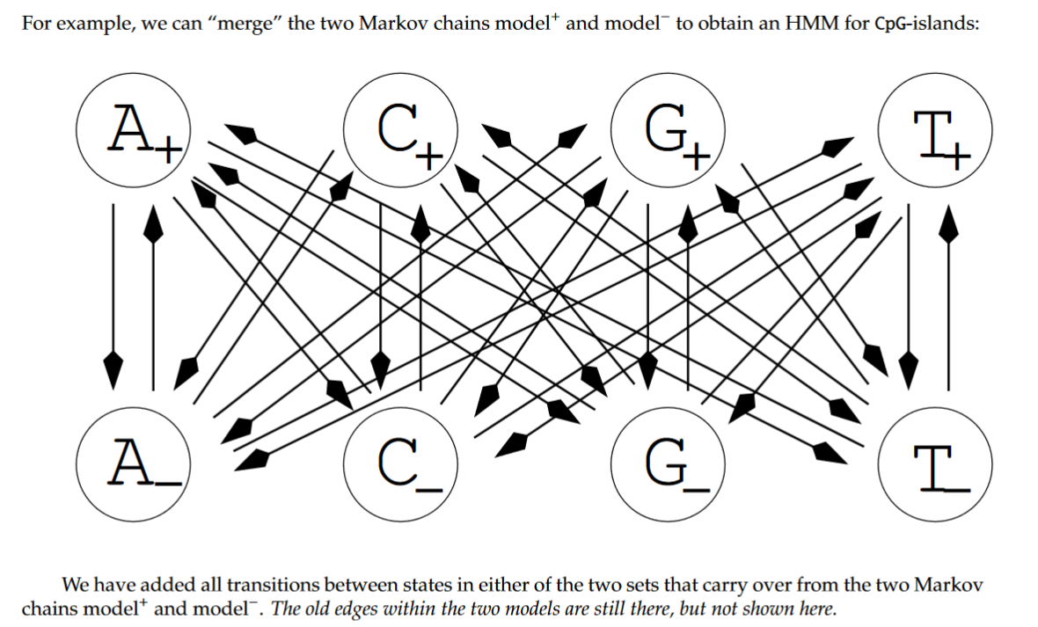
HMM for CpG-islands

Slide 28
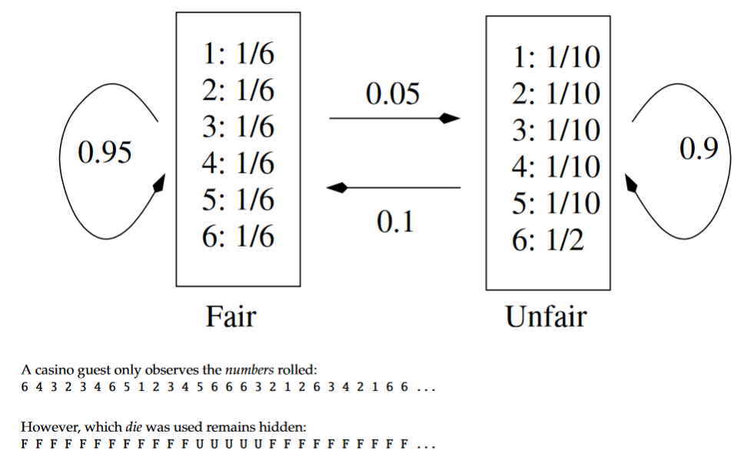
HMM Example: Fair/Loaded Die

Slide 29
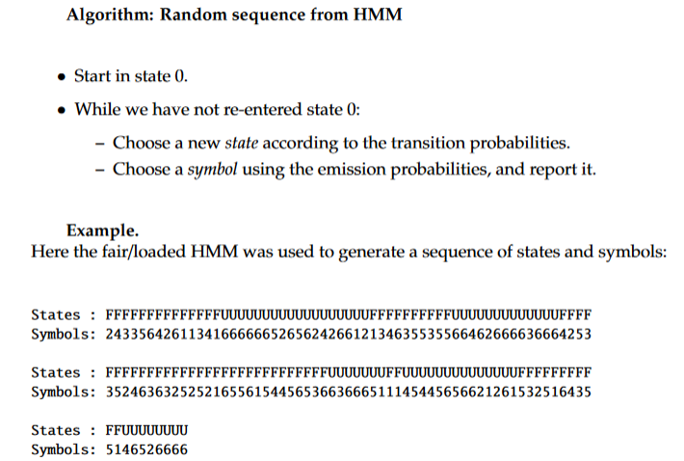
Generation of Simulated Data
MATLAB Function
[seq, states] = hmmgenerate(1000,TRANS,EMIS)

Slide 30
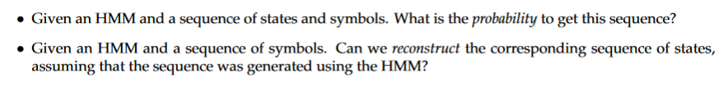
Questions

Slide 31
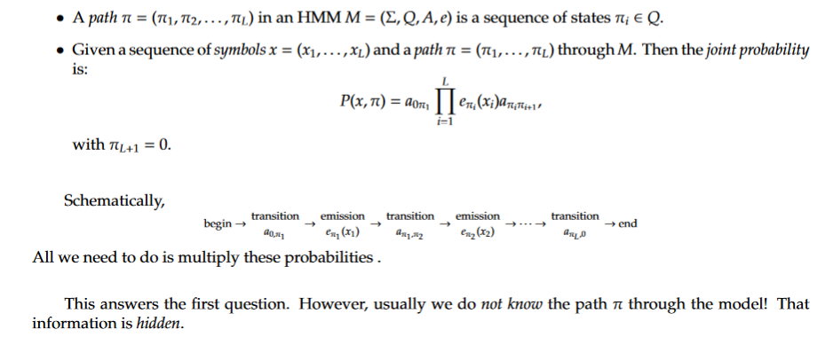
Probability For Given States & Symbols

Slide 32
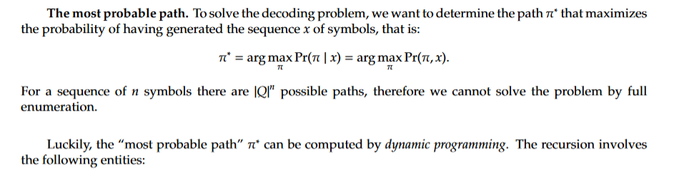
The Decoding Problem
MATLAB Function
likelystates = hmmviterbi(seq, TRAN, EMIS)

Slide 33
Algorithmic Tasks For HMM
2.
PSTATES = hmmdecode(seq, TRANS, EMIS)
The output PSTATES is an M-by-L matrix, where M is the number of states and L is the length of seq. PSTATES(I,j)
is the conditional probability that the model is in state I when it generates the jth symbol of seq, given that
Seq is emitted
3
[TRANS_EST, EMIS_EST] = hmmestimate(seq, states)

Slide 34
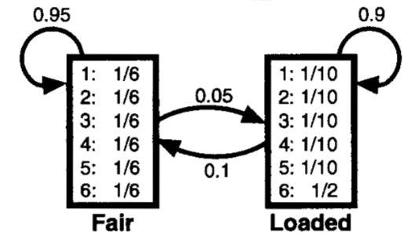
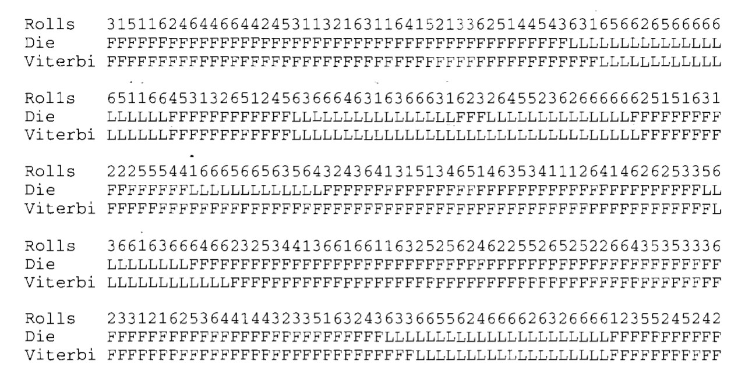

Slide 35
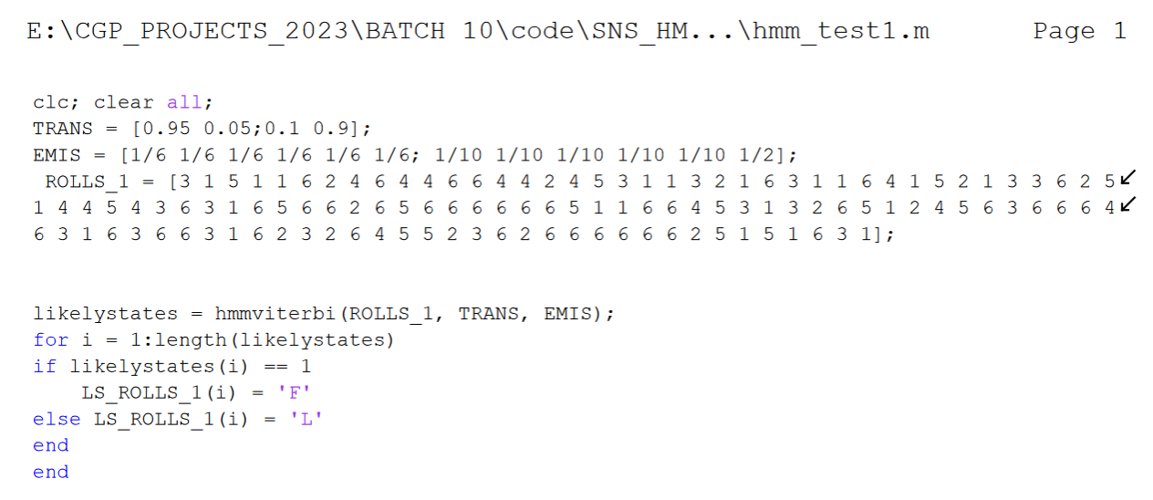
MATLAB Code for the Fair/Loaded Die

Slide 36
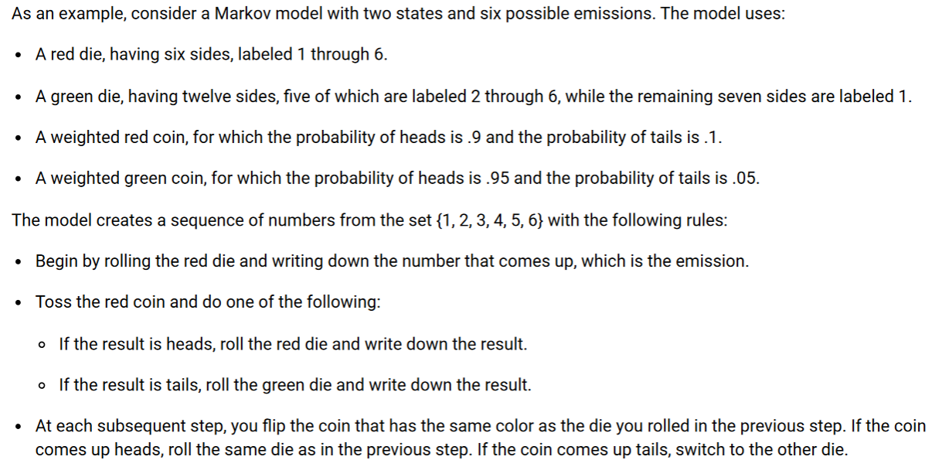
Another HMM Example

Slide 37
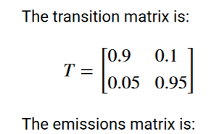
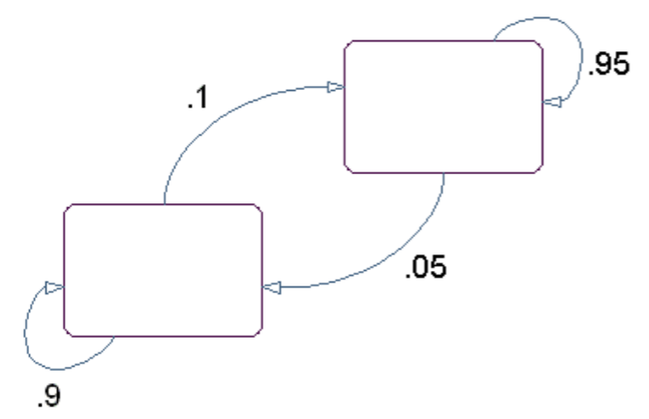
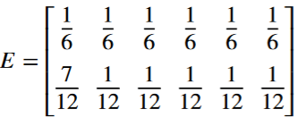
State Diagram for the Model

Slide 38
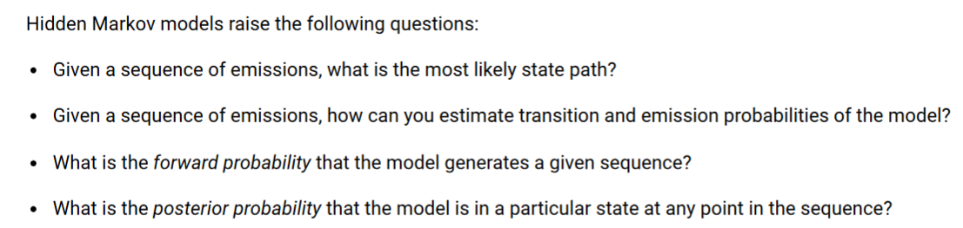
HMM Questions

Slide 39
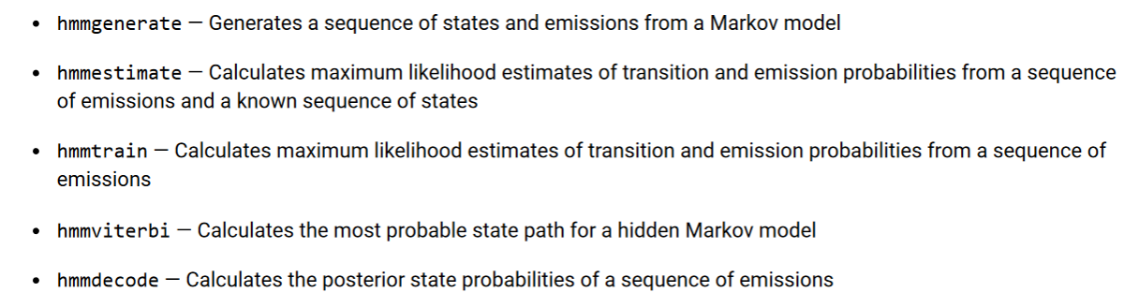
Statistics and Machine Learning Toolbox Functions Related to HMM

Slide 40
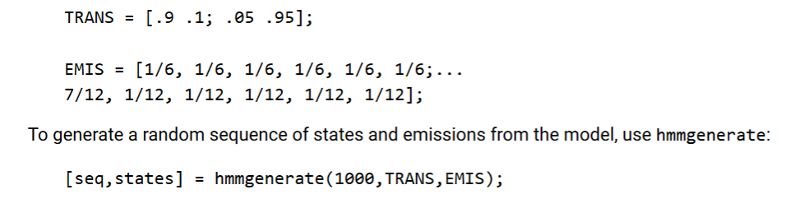
Generating a Test Sequence

Slide 41
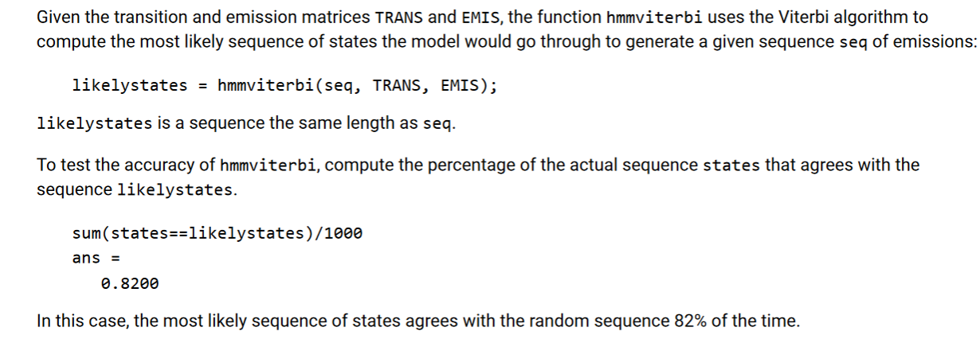
Estimating the State Sequence

Slide 42
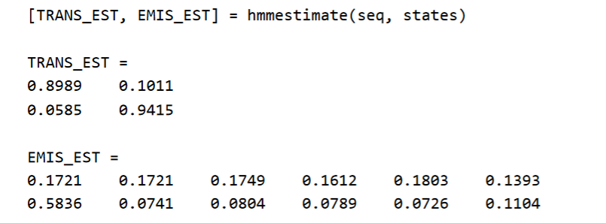
Estimating Transition & Emission Matrices

Slide 43
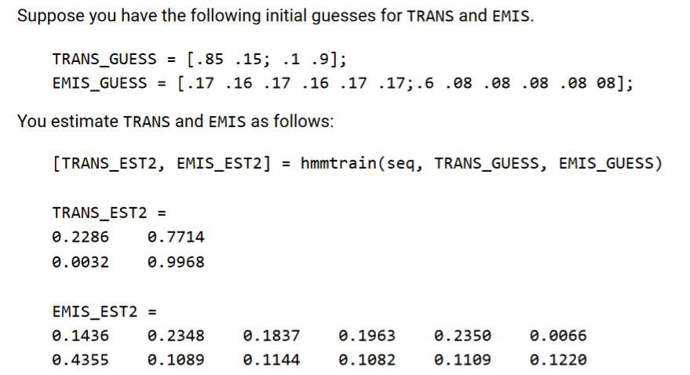
Using hmmtrain

Slide 44
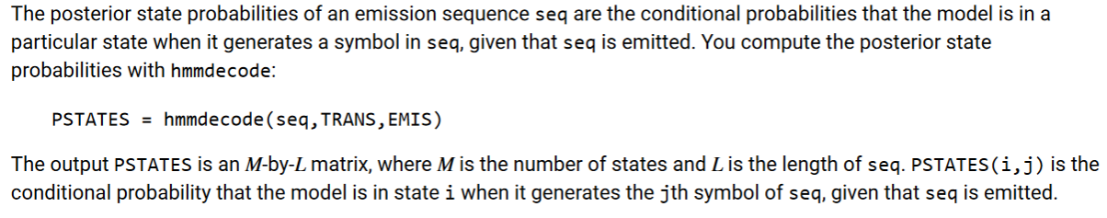
Estimating Posterior State Probabilities
plot(1:length(seq),PSTATES(1,:),'r', 1:length(seq),PSTATES(2,:),'g')

Slide 45
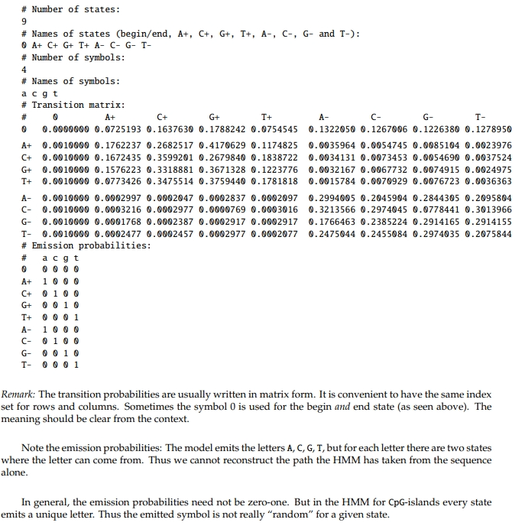
HMM for CpG Islands

Slide 46
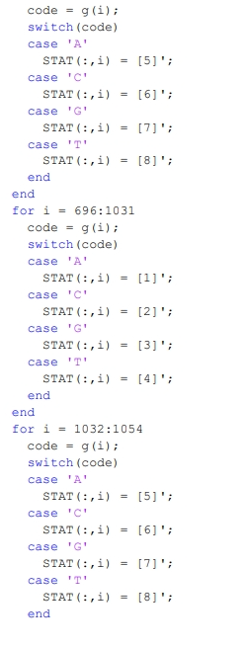
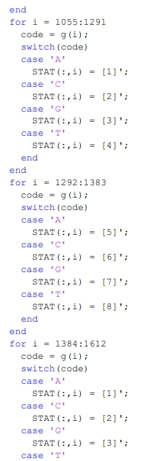
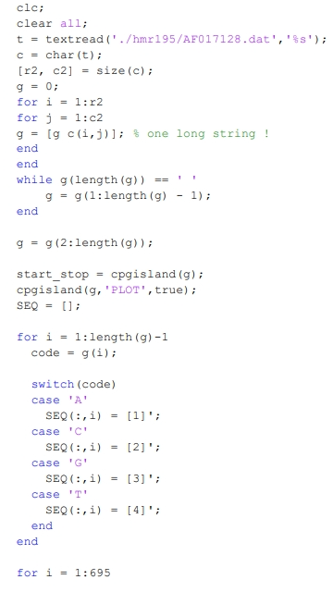
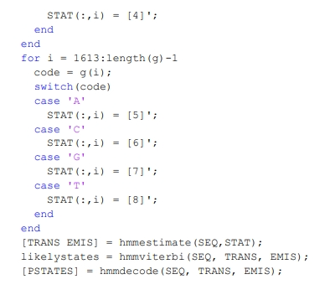

Slide 47
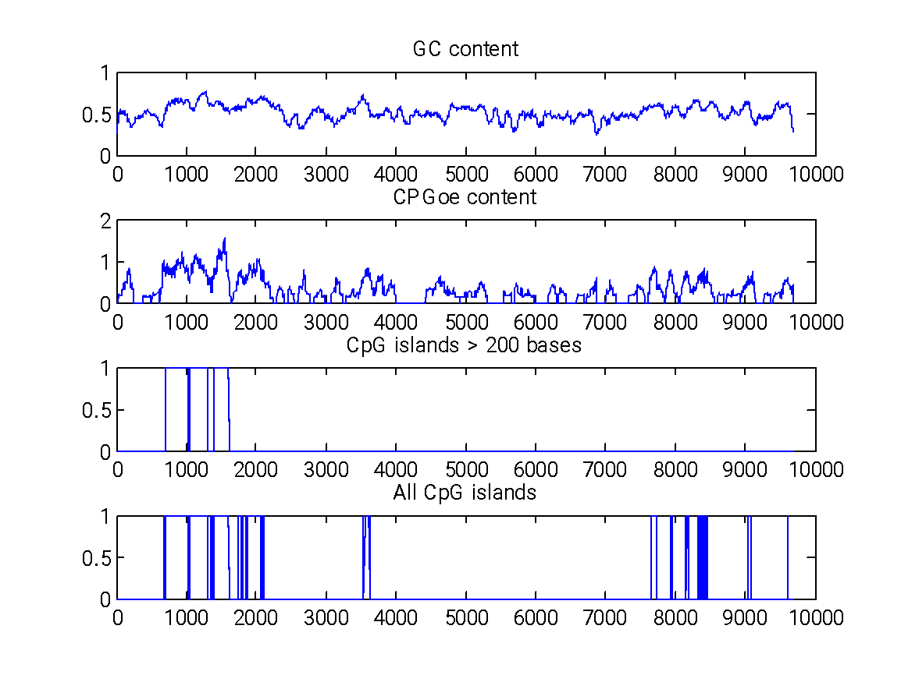

Slide 48
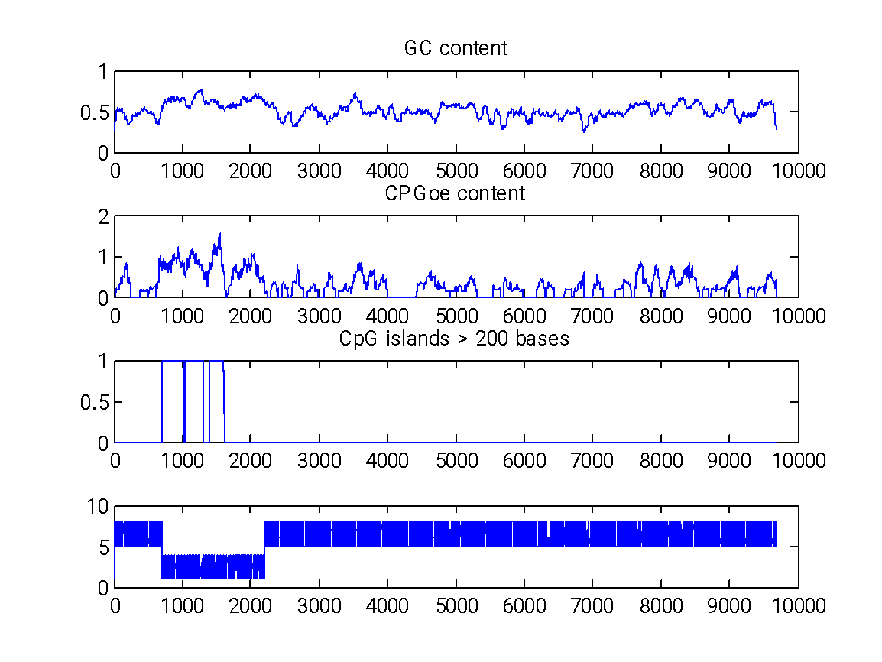

Slide 49
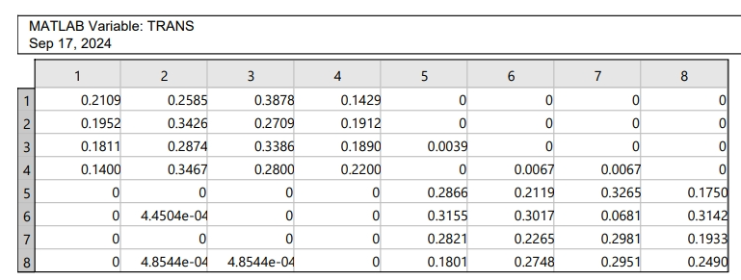
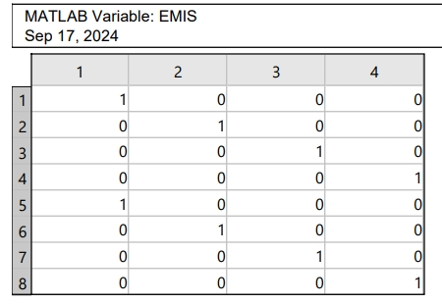
start_stop =
Starts: [696 1055 1384]
Stops: [1031 1291 1612]

Slide 50

Human Chromosome 22 09 Contigs

Slide 51
CpG Islands
Link to get CpG island locations in the 09 contigs of Chromosome 22-
https://www.cs.rice.edu/~devika/comp470/hw1/ncbimapBuild_36.3_22_cpg_0K.txt

Slide 52


Slide 53


